Slide 1
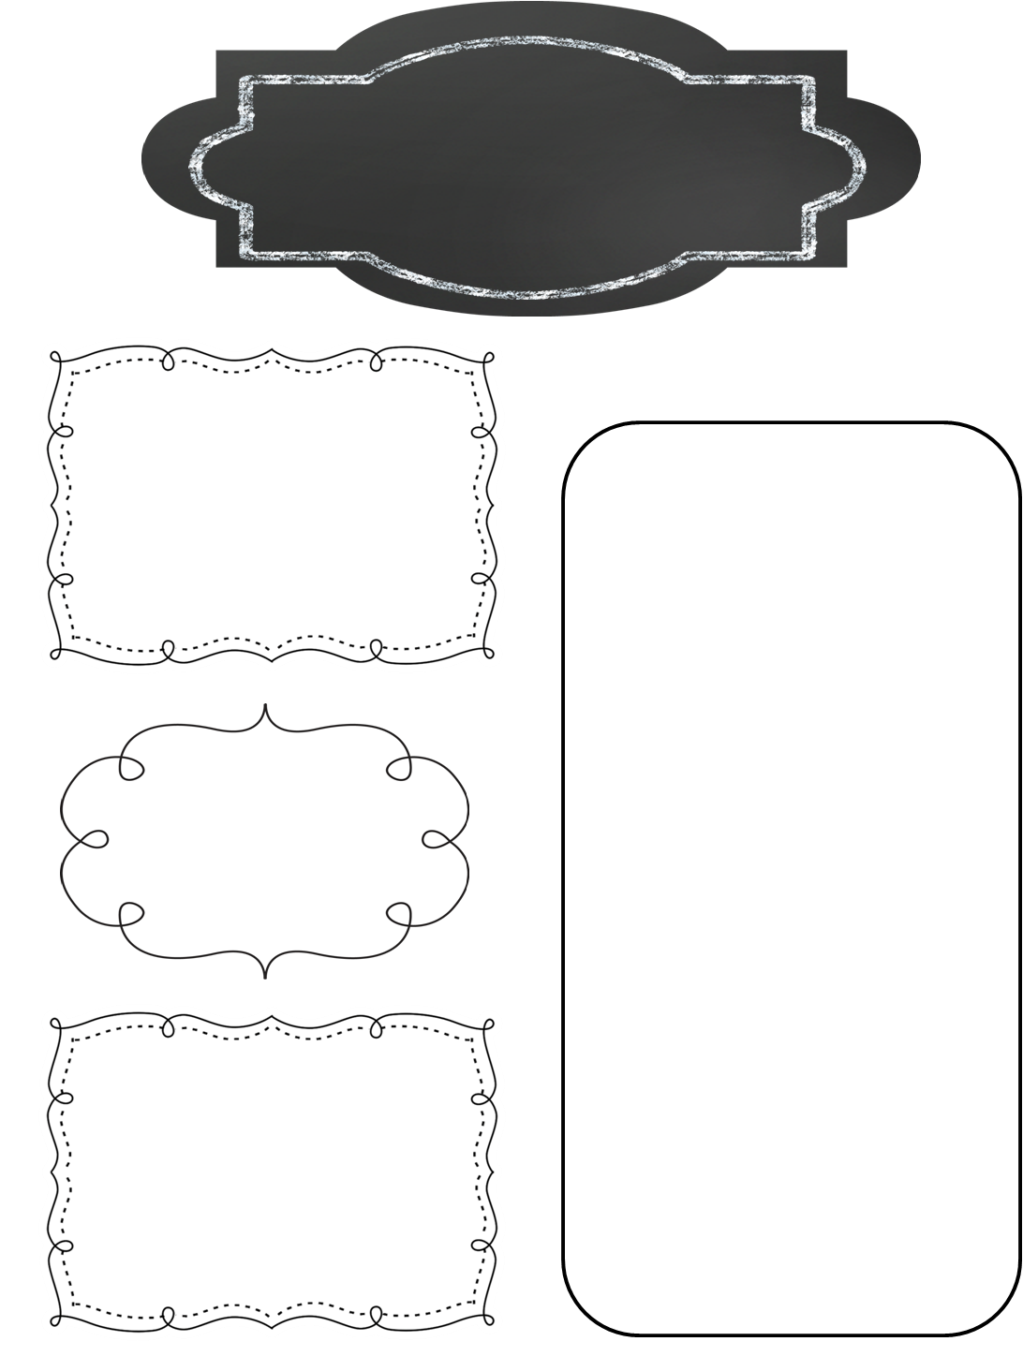
A Peek at This Week in…
Mrs. McFarland’s Class
Week of December 2nd
Please continue to help your child review multiplication math facts. We will be having a math fact competition at the beginning of December to compete against other 5th grade homerooms. I hate to say it, but I don’t like losing so let’s get those facts mastered!
Reminders
Math (McFarland)
Chapter 12: Geometry
Triangles
Quadrilaterals
Volume
Reading (McFarland)
Please see the attached Focus Wall for vocab words, spelling words, and skills/ strategies for U2L10.
Vocab/comprehension/ language assessment is Friday.
Students should continue to read for AR. The deadline is December 19th. Students were assigned individualized points this time.
Spelling (McFarland)
Schwa + r sound
Test Friday
Upcoming Events
Language Arts/Writing (McFarland)
Wednesday, December 4- Preview Penguin Patch Holiday Shoppe
Friday, December 6: Penguin Patch Shop will be open
Friday, December 6th: Math Facts competition 2-2:55p
Thursday, December 12th: Last day of after school tutoring until after break
Tuesday, December 17th: NMIS Christmas program 6:30 pm
Compare/contrast writing
Finish narrative writing
Science/ Social Studies (Eldridge)
Science: Ch. 4 Ecosystems
Social Studies: N/A

